Slide 1
CAPSTONE PROJECT PRESENTATION
AKARSH SINGH

Slide 2
INTRODUCTION
To find out the best places to hangout in Mumbai to present to a tourist company for marketing and advertisement

Slide 3
Data Resources
Foursquare API
Wikipedia
Geojson
Python libraries

Slide 4
Steps and Approach
Collect the respective data and convert it into a dataframe
Clean the data frame according to our requirement
Concatenate the dataframes and visualize the dataframe using various techniques and maps
Conclude the respective study with appropriate solutions

Slide 5
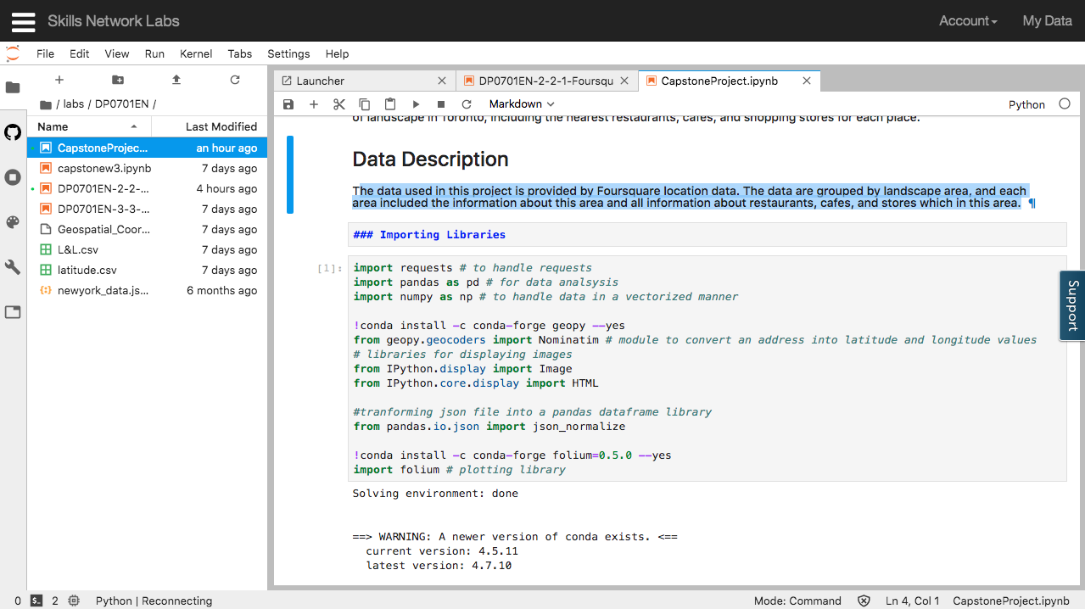
Importing libraries

Slide 6
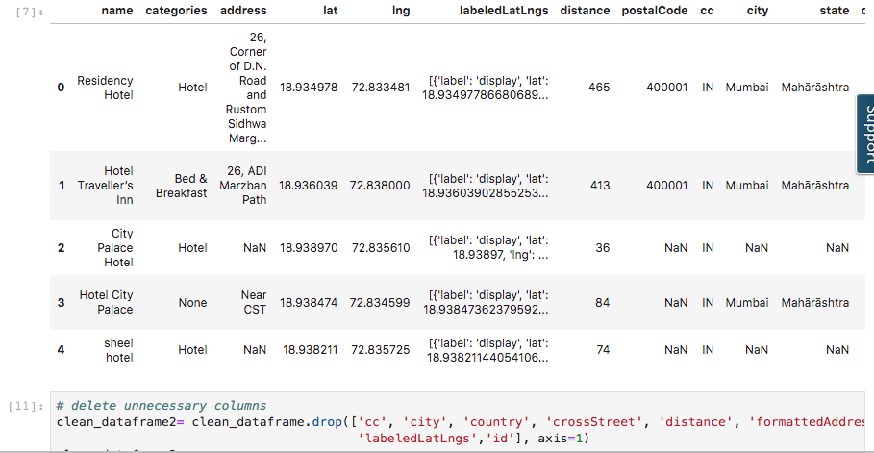
Importing the data

Slide 7
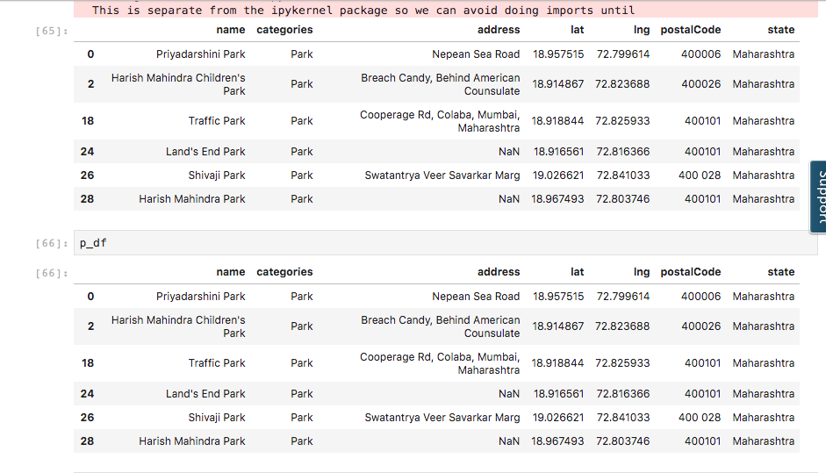
Sorting the data

Slide 8
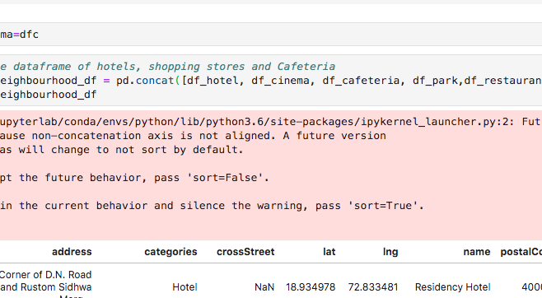
Concatenation for visualization

Slide 9
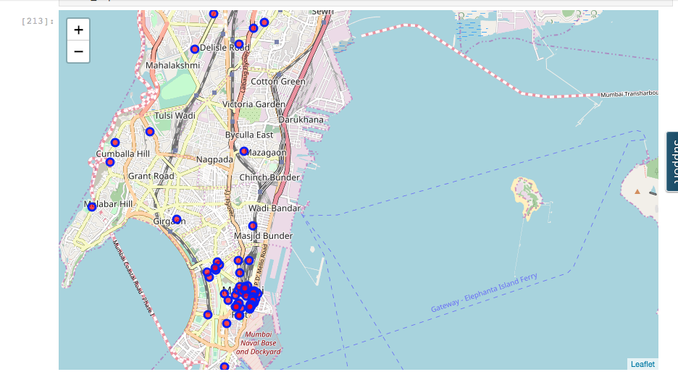
Final Visualization

Slide 10
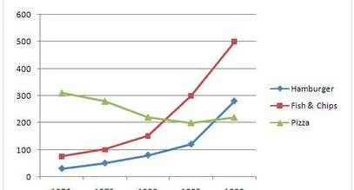
Popularity of food at restaurants

Slide 11
Conclusion
From this study we conclude that the most popular hangout spots in Mumbai are Fort and Colaba with the maximum number of restaurants,parks and multiplexes

